Slide 1

Introducing HAIKO
Dynamics 365 Mobile Digital Transformation

Slide 2


Your customer and business data is stored and managed in Dynamics 365. Customers call to raise support tickets, enquire about services and update details

Slide 3


Customers today expect any-time, instant access. this year 85% of time spent on amazon was via their app

Slide 4

Mobile app development is costly. Apps of medium complexity often cost over £100,000 with ongoing maintenance costs of 20% per annum

Slide 5

Haiko place digital mobile at the centre of your business

Slide 6

We give you a branded app available to install from the apple and android stores
your company. your data. your app
Powered by Haiko

Slide 7
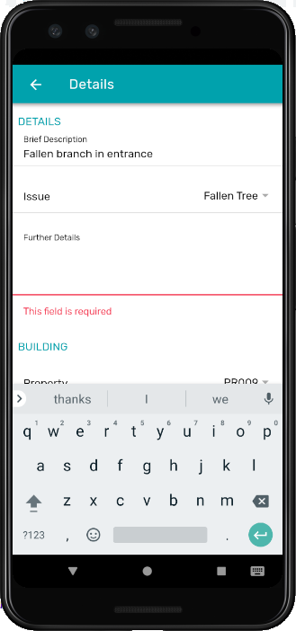
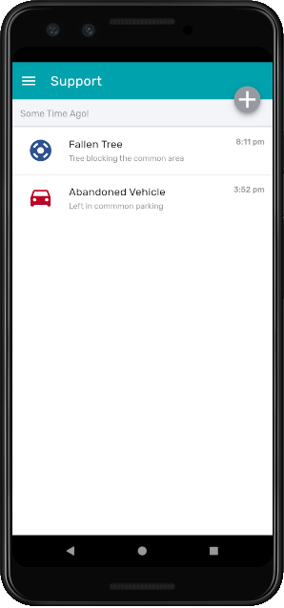
With your app, customers can submit, update and monitor service-desk cases
All integrated with dynamics 365

Slide 8

reimagine support
Your Haiko-powered app allows customers to attach photos and video to cases and enquiries

Slide 9
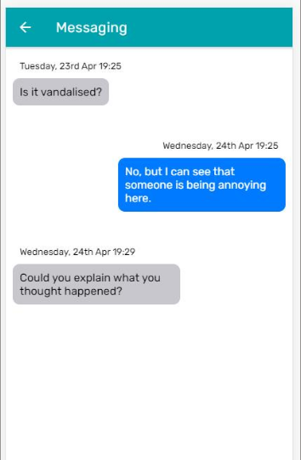
Service desk agents can request information via Haiko’s familiar chat interface

Slide 10

Build your app using Haiko’s exclusively no-code configuration in dynamics 365
Add pages, configure forms with validation, and customize the walkthrough intro

Slide 11
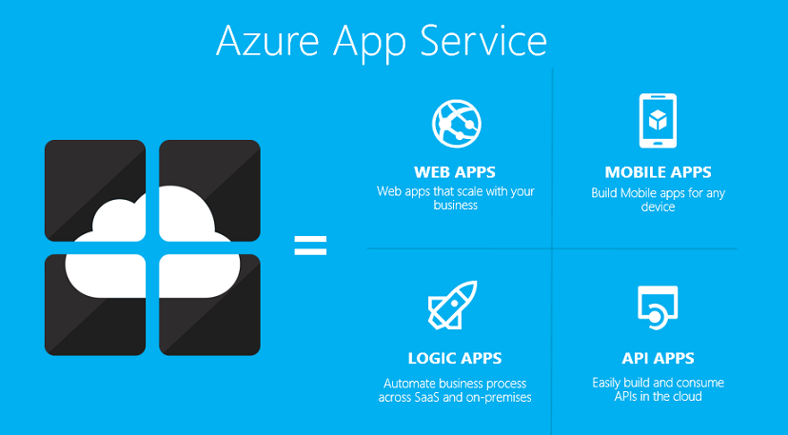
Use Haiko to integrate your app with the Microsoft azure cloud
Transform your business with the power of logic apps
All no-code

Slide 12
HAIKO
Mobile Digital Transformation

Slide 13

Visit us at
www.haiko-app.com

